Slide 1

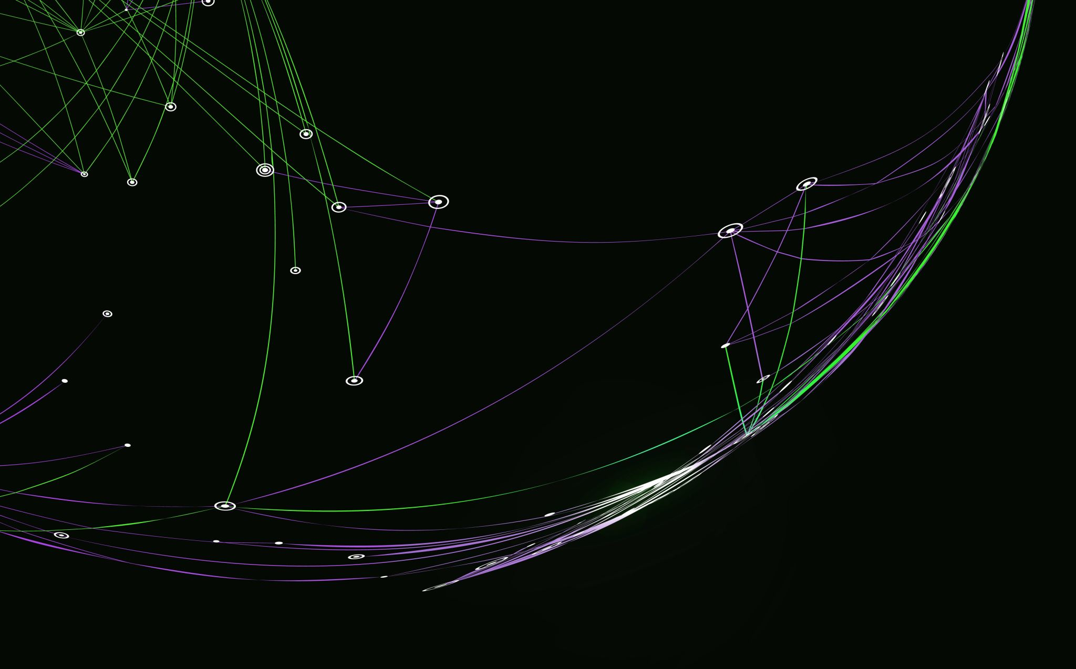
Picture Pixel
Ellie Williams

Slide 2
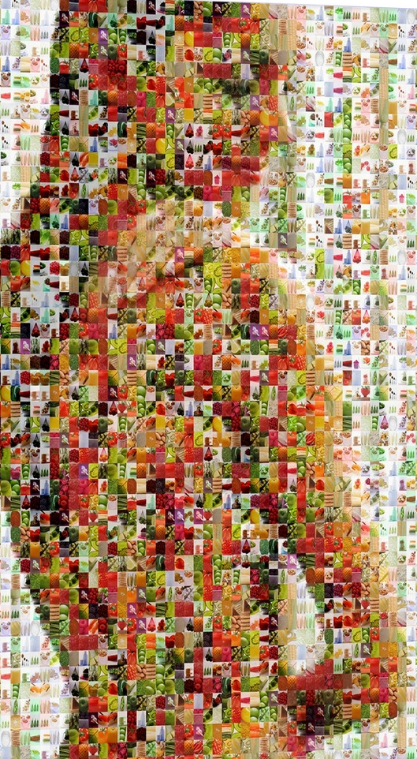
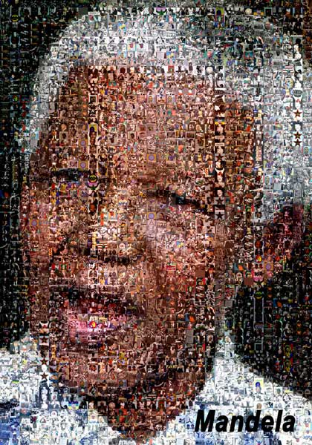
Inspiration

Slide 3
The Start
Goal:
Create flexible code that allows a select group of photos to be used in the creation of a larger image
Starting Point/Possible Ideas:
Take pictures from artists and make their portrait
Take photos from this trip and make a group photo
Make it user-friendly and have it susceptible to any downloaded collection of images

Slide 4
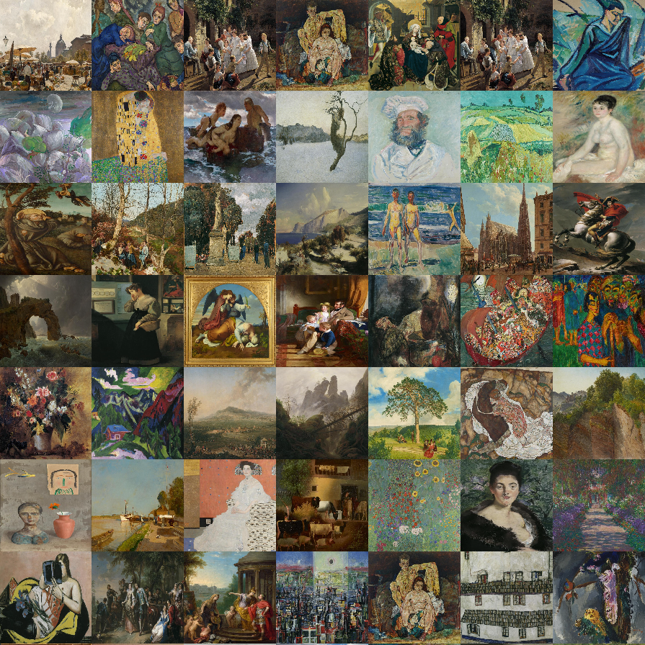
The Middle

Slide 5

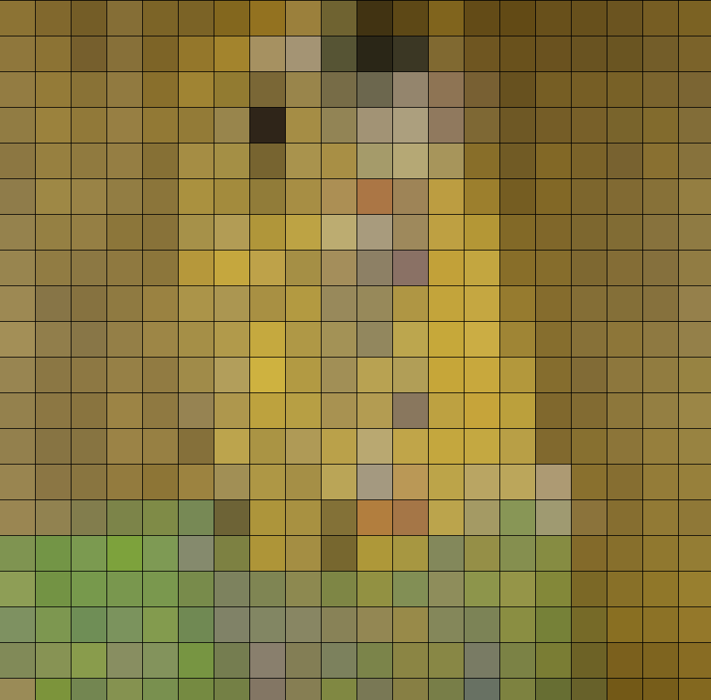
The Middle
Fixing the code so that each box is actually finding the average color
  It was instead only doing one row and one column
Fix the code from comparing the color and the one before it versus comparing the color with all of the ones before it

Slide 6
The End
Uses artworks from the Belvedere as the smaller images
Takes the average of RGB values in all of the pixels in the smaller images and compares it to the average RGB values in a chunk of the larger image
The smallest difference in shade is the picture that gets chosen to replace that chunk (placed over)

Slide 7
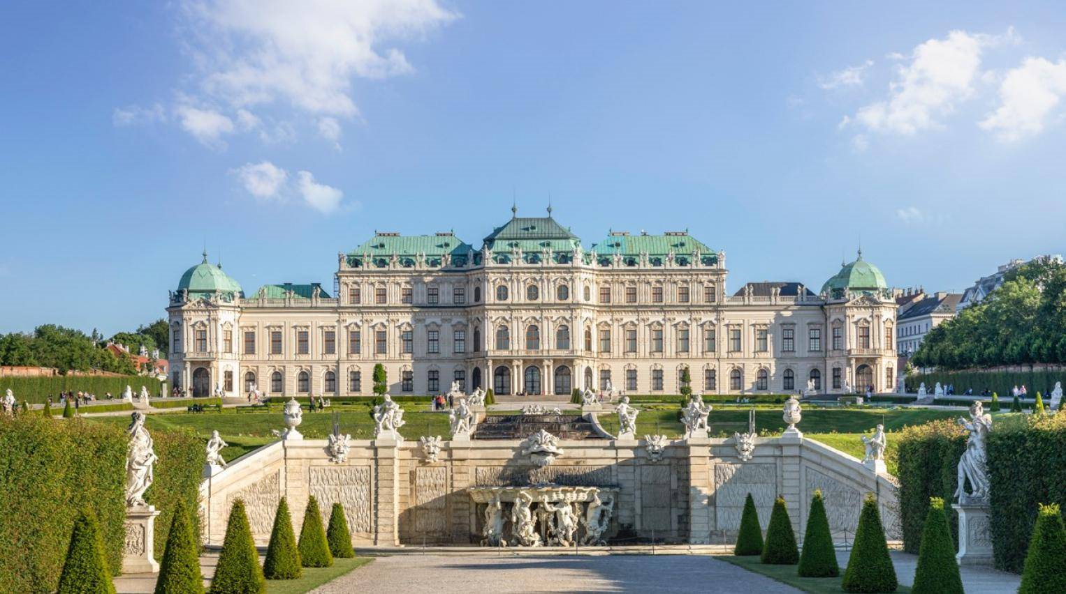
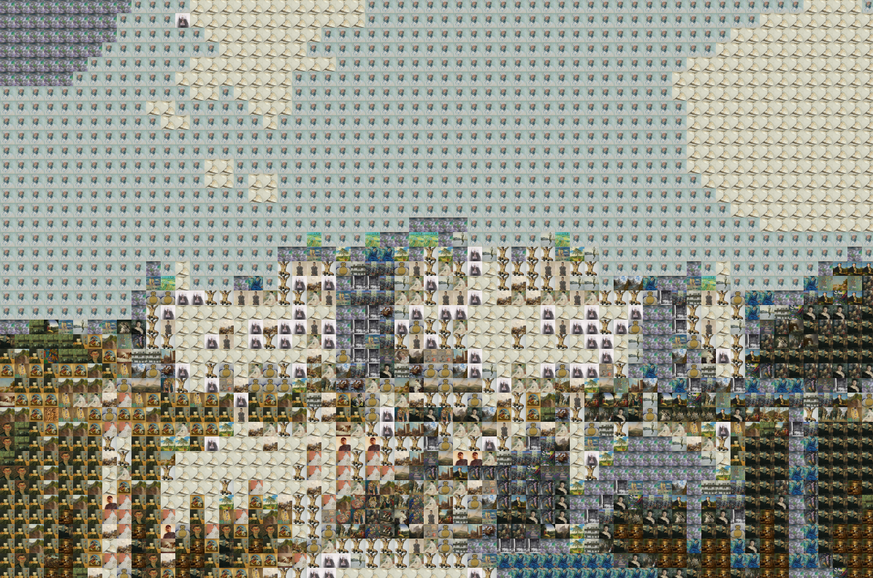

Slide 8
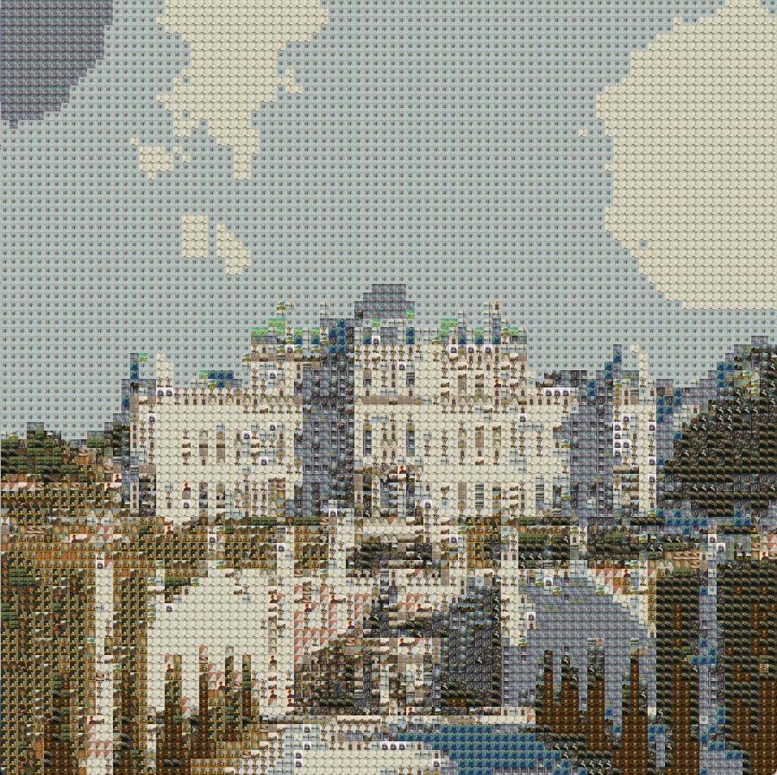
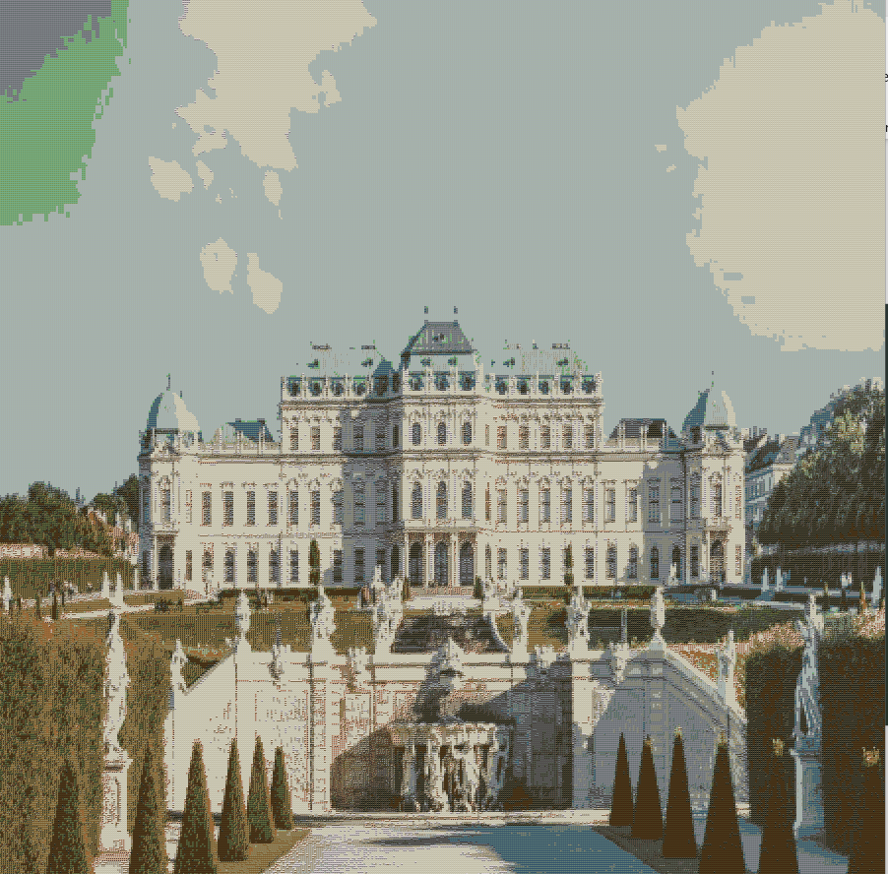

Slide 9
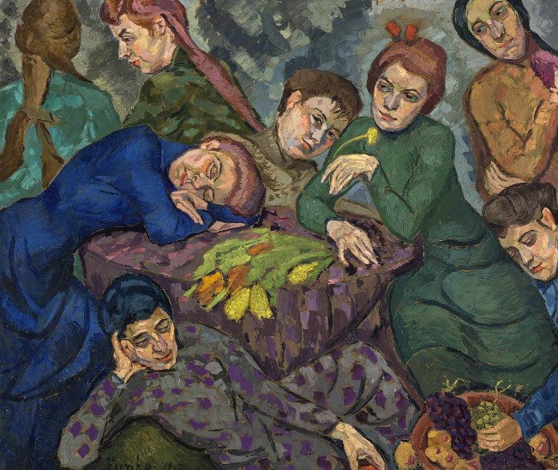
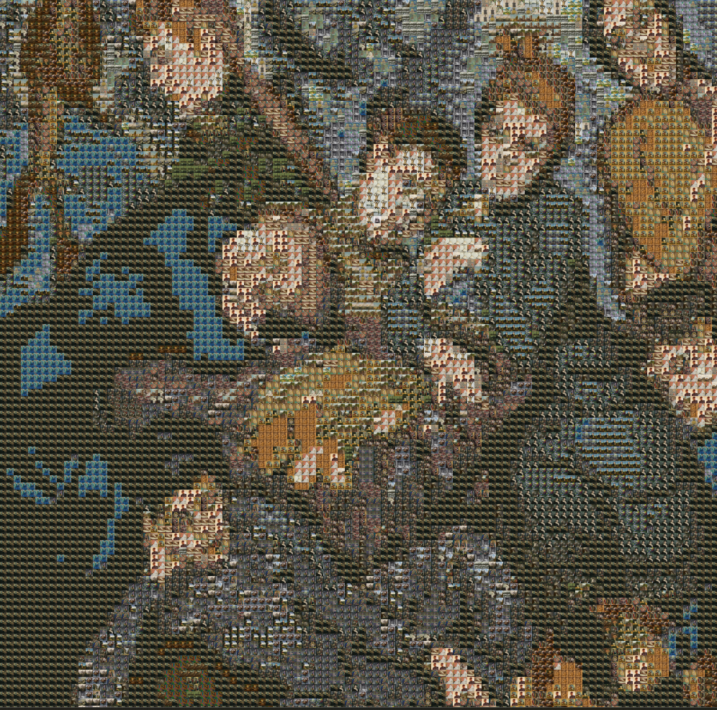
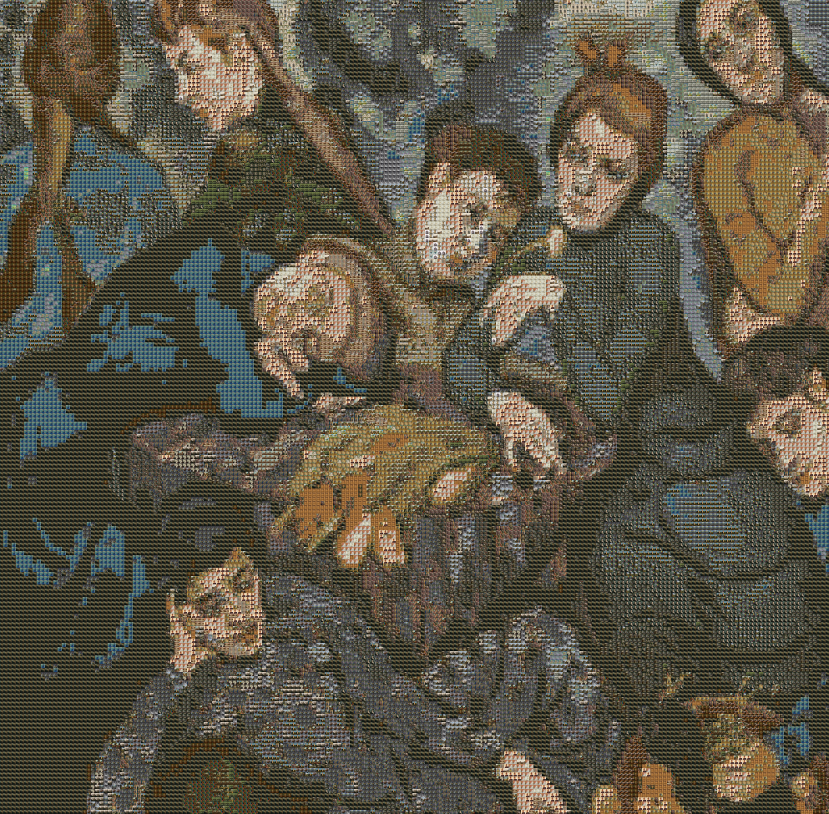

Slide 10
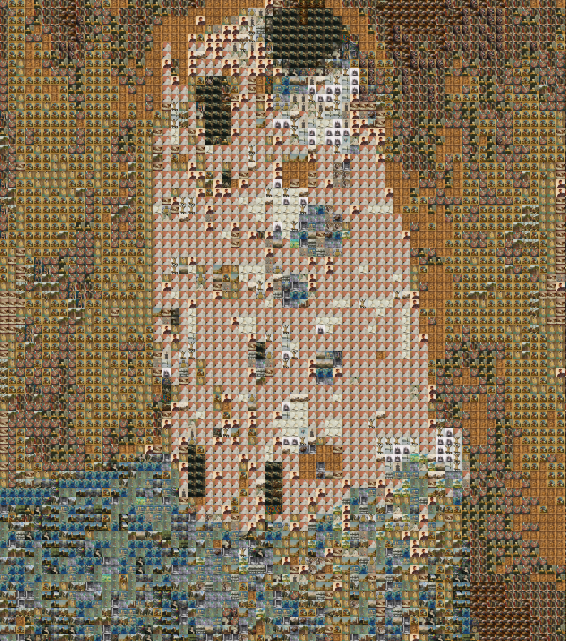
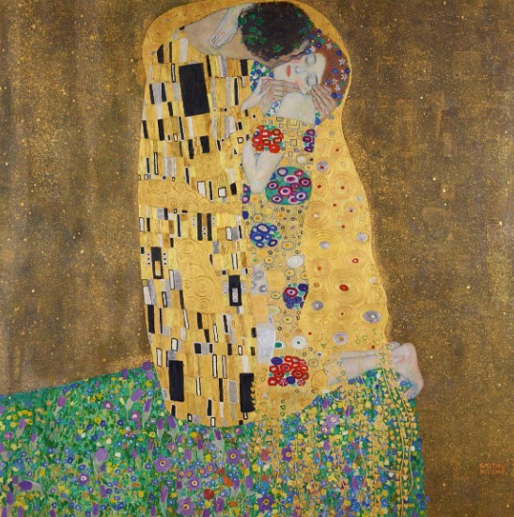

Slide 11
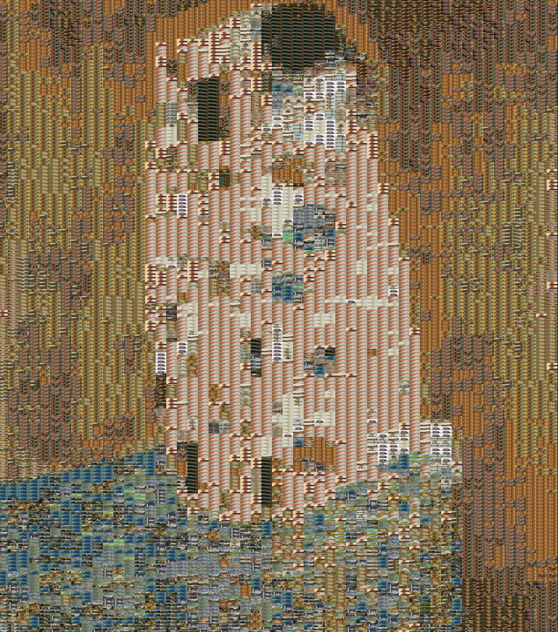
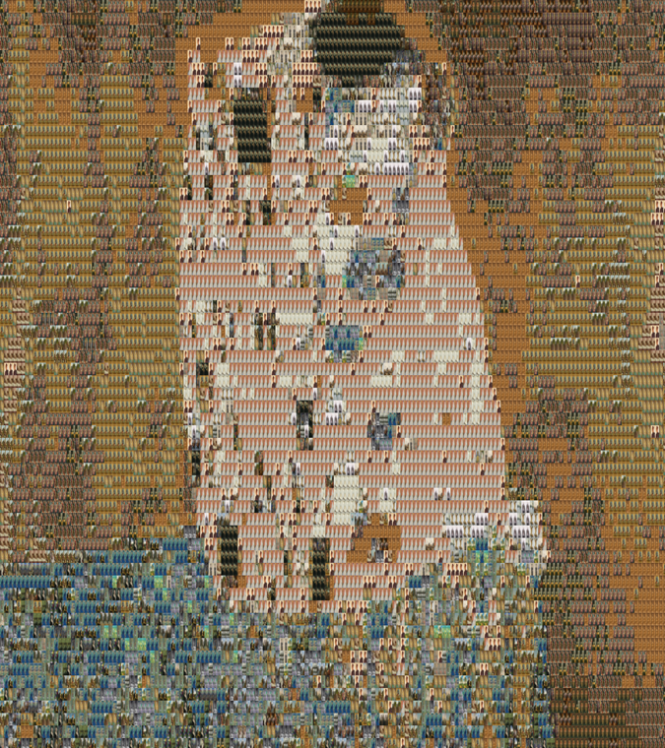

Slide 12
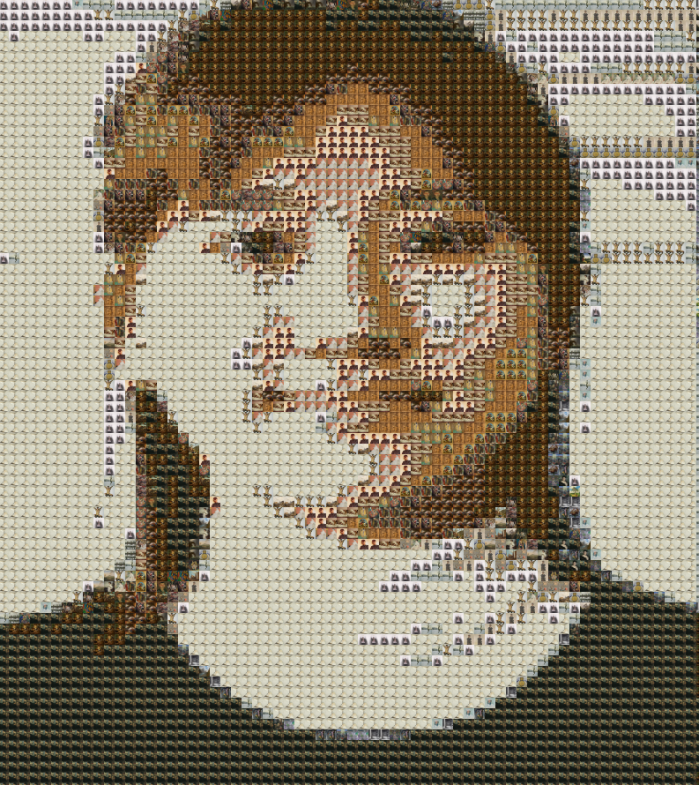
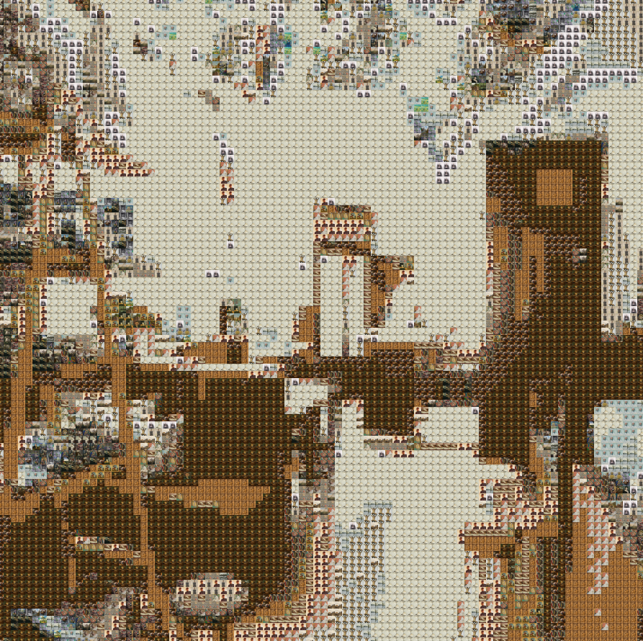

Slide 13
Improvement
Add different types of image bases
Have transparency be included so that there is overlapping communication between the smaller pictures
Make the color comparison more precise

